Slide 1
Implementation of WHO MEC recommendations
27 July 2018
Amsterdam, The Netherlands
Petrus Steyn
Scientist, WHO/RHR

Slide 2
Outline
Complex relationships between research and health policy
Evolution of policy
Challenges and successes in guideline implementation
Country experiences
Conclusions

Slide 3
Complex relationship between research and global health policy
Ongoing controversy regarding the association of HIV acquisition and hormonal contraception, and in particular, progestogen-only injectable contraceptives (POIs).
Best quality studies suggest a hazard ratio of 1.4 (1.2, 1.7) for HIV acquisition in women who use the POI Depot Medroxyprogesterone Acetate (DMPA).
2016 Polis et al. AIDS

Slide 4
Need for transparent, up-to-date policy
High HIV prevalence areas also experience maternal morbidity due to pregnancy complications and unsafe abortion
These same countries often have a limited variety of available contraceptive methods, and POIs such as DMPA and NET-EN are familiar and popular methods.
28.8% of contraceptive users in the Southern Africa region use POIs [2].
Complicated risk-benefit scenarios models

Slide 5
WHO sexual and reproductive health guidance
Continually reviews current research
Creates and disseminates recommendations to reflect the best health practices with a human rights-based approach
Critical careful translation of research findings into guidelines is for impacting the eventual health outcomes of women globally.
Challenges of health policy guidance and how simple research questions can have very complicated implementation answers.

Slide 6
Evolution of Policy
The cornerstone of WHO guidance on contraceptive safety is the maintenance of an up-to-date reference for policy makers, programme managers and health care providers called Medical eligibility criteria for contraceptive Use (MEC)
5th edition contains 2000 recommendations for 25 different methods addressing 80 different medical conditions or patient characteristics
Four-tiered classification stratified by safety for using a contraceptive method given a specific condition

Slide 7
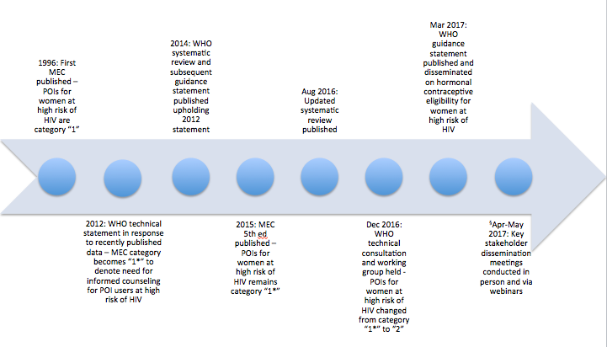
Evolution of Policy

Slide 8
Challenges and successes of guideline implementation - Messaging
The gradual evolution of POIs moving from MEC category 1 to 2 make recommendations adequately reflecting the analyses of observational data with serious limitations, while avoiding drastic shifts in global family planning policy.
WHO conducted repeated meetings with stakeholder groups both prior to and following the latest policy recommendations.
This also gave WHO opportunities to reinforce its most important messages: 1. Women and girls at high risk for HIV should not be denied any method of contraception, 2. Rights-based counseling is necessary for to make an informed choice; 3. Policies and programmes needed to emphasize dual protection from unplanned pregnancy and STIs/HIV, and; 4. Women and girls should be given multiple contraceptive options for preventing unwanted pregnancy.

Slide 9
Challenges and successes of guideline implementation - Timelines
Policy implementation often lags significantly behind research publication.
WHO worked to efficiently respond to the research findings and ensure that new guidance was published in a timely fashion to assist the key stakeholders in interpreting and implementing the findings.
WHO consulting experts in infectious diseases, obstetrics & gynecology, evidence-based medicine, epidemiology, and pharmacology, and stakeholders representing key populations at high risk of HIV infection
As research in this area continues to shape our understanding of HIV acquisition in POI users, prompt policy guidance is essential.
Notes:
.

Slide 10
Challenges and successes of guideline implementation - Engagement
Translation of research findings to policy statements can have rapid implications for a large breadth of stakeholders
Significant impact for governmental HIV and family planning programmes globally, and in particular, for countries with a high HIV burden.
HIV and contraceptive programmes of non-governmental organizations (NGOs) that support Ministries of Health (MoH)
Civil society and patient advocates groups provide the most direct feedback of policy impact on the ground level.

Slide 11
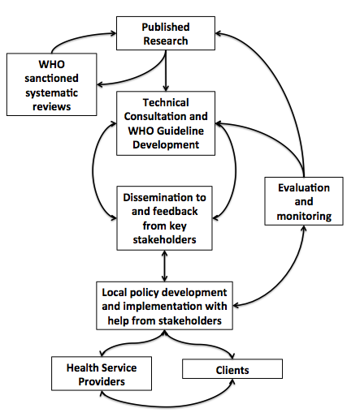
Challenges and successes of guideline implementation - Engagement

Slide 12
Challenges and successes of guideline implementation - Research
Further research is needed to clarify the uncertainty surrounding POI use and HIV transmission..

Slide 13
Challenges and successes of guideline implementation – monitoring and evaluation
Monitoring the implementation of new guidelines among key stakeholders.
Technical support to regional and country representatives as well as policymakers.
Monitor the effects of policy changes through direct engagement and research.

Slide 14
Summary
The impact of published research on health outcomes is not straightforward.
Often major research findings rely on slow, organic infiltration into practice norms.
Large health organizations can expedite this process by translating research into guidelines and systematically disseminating them to member states and organizations.
Inputs into these guidelines are often imperfect.

Slide 15
Country experiences

Slide 16
Background
The WHO statement on use of hormonal contraceptives in women at high risk of HIV was of special importance to ESA due to high HIV prevalence coupled with high DMPA utilisation
ESA Countries that attended the 2016 meeting include: Botswana, Kenya, Lesotho, Malawi, Mozambique, Namibia, South Africa, Swaziland, Tanzania, Uganda, Zambia and Zimbabwe; and almost all have subsequently revised their national FP guidelines and tools (Swaziland had already revised FP guidelines in 2015).
In many countries, concerns regarding the health risks of contraception are among the most common reasons for non use of contraception

Slide 17
Summary actions: Zimbabwe, Zambia and Botswana
Zimbabwe: Shared the recommendations with ZNFPC and other MOH stakeholders.
Noted; DMPA should still be used regardless of woman’s HIV status as the re-categorization did not limit its use.
Zambia: The statement was shared to all members of the FP TWG ;
adapted Zambia MEC wheel incorporated the new category for DMPA/ HIV;
National RMNCAH communication strategy is in development and incorporates the new FP guidance
Botswana: Statement on HC/ HIV disseminated in different forums.
FP guidelines and MEC wheel revised.
FP guidelines, the following statement was included: ‘There continues to be evidence of a possible increased risk of acquiring HIV among POI users at risk of HIV. However since the advantages of this method outweighs the possible increased risk of HIV acquisition they are in MEC 2’.
17

Slide 18
Summary actions: Uganda
Most FP stakeholders were already aware of the statement. WHO guidance were disseminated to the MCH technical working group.
In process of finalizing communication strategy and stakeholders meeting will be convened with academics, partners, and women to agree on appropriate messages to deliver to population.
Intensified training on other FP methods ongoing so that if ECHO and other studies confirm the relationship of DMPA/ HIV, clients can easily select other methods.
More messages on HIV prevention including PrEP developed and disseminated.

Slide 19
Summary actions: Tanzania
Statement presented in the Family Planning Technical Working group
Endorsed the recommendations and set up a smaller team to prepare communication materials to facilitate the discussion with the Ministry of Health Management. National FP guidelines and training package revised in line with WHO MEC 2015 and updates on Hormonal Contraception and HIV;
Adapted MEC wheel also took cognizance of re-categorization.
Ongoing capacity building for expanded method mix;
Joint meetings with HIV counterparts to ensure consistent messaging.

Slide 20
Summary actions: Namibia
Members of the National MCH Committee which includes SRH and HIV partners were briefed and the WHO statement.
Discussed at National workshop for the adaptation of the 2017 MEC Wheel in September 2017.
The re-categorization was captured in revised MEC wheel.
Clarification included in counselling training.

Slide 21
Conclusions
Significant dissemination of the WHO statement has taken place in countries
Some countries concerned about the communication focusing on DMPA / HIV since the evidence is not conclusive and results of the ECHO-trial
Most countries however, received the information positively but felt that it made little difference to their service delivery as they still counsel for dual contraception in WLHIV, and the categorization still recommends that DMPA can generally be used.
Many countries have accelerated capacity building efforts to enhance the method mix/ choice especially the LARCs

Slide 22
WHO’s commitment
To continually review it recommendations on contraceptive eligibility
Strongly supports the need for further research to address the twin epidemics of HIV and unintended pregnancy

